Slide 1






Slide 2





Slide 3

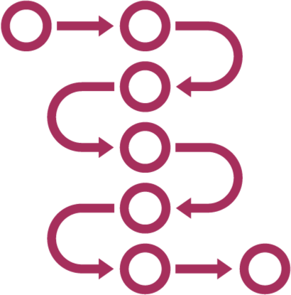






Slide 4













Slide 5














collab = new Collaborator()
◀
uut = new UnitUnderTest(collab)
◀
result = uut.exercise()
◀
assertSomething(result)
teardown()
◀
◀

Slide 6

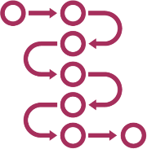





Slide 7




mockCollab = mock(Collaborator.class)
◀
mockCollab.expectation()
◀
uut = new UnitUnderTest(mockCollab)
◀
result = uut.exercise()
◀
verify(mockCollab)
teardown()
◀
◀

Slide 8







Slide 9




Slide 10








Slide 12












Slide 13






Slide 14





Slide 15





Slide 17



















Slide 18

expect(mock.mockedMethod(
◀
…params…
)).andReturn(result);
expect(mock.mockedMethod(
…params…
)).andStubReturn(result);
◀

Slide 19












•
•
•
•

Slide 20


Slide 21











